Slide 1
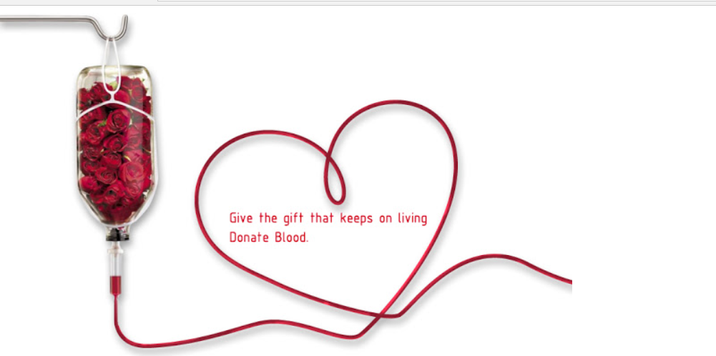
ONLINE BLOOD DONATION SYSTEM

Slide 2
ABSTRACT
Blood donation is required during an organ transplant, accidents, cancer treatment etc. For blood donation, one needs to check for a donation camp or needs to visit blood bank. The Manual Blood donation system has many disadvantages. This online blood donation management system maintains the list of blood donors and also helps the recipients to track and search the right donor easily. This project aims at maintaining all information regarding blood donors, different blood groups available in blood banks as wells as blood camps and help them manage in a better way.

Slide 3
INTRODUCTION
It has two modules namely Admin and User. Admins can add hospitals having blood banks and can also add various blood donation camps. He/she can also view the list of donors of a particular area with proper Blood cross match. He/she can also check for blood requests and in case of emergency he/she can send notifications to blood donors as per the requirements. Users can register and make a request. Users can also register as a donor. Donors can check for Blood camps and hospitals for blood donation and will be getting notifications in case of emergency. They can either accept or ignore it.

Slide 4
MOTIVATION
The Online Blood Bank has motive for the social service. The bank has details of the all donor and recipient information. The Bank has many registered donors who have always focused to donate blood for emergency. Our job is completed by having the donors and their details, the recipient has to contact, if they seek blood.

Slide 5
REQUIREMENTS
Functional requirements:
login:
The system provides security features through username and password matching where only authorised users can access the system with different authorization level.
Donor profile registration:
This allows healthy public to register as volunteer donor.
Blood stock management:
The blood bank staffs can manage the blood stock starting from the blood collection, to blood screening processing storage, transference and transfusion through this system.

Slide 6
Non-Functional requirements:
Availability:
The system should be available at all times, meaning the user can access it using application.
In case of hardware failure hardware failure or database corruption,a replacement page will be shown.Also backup of the database should be retrieved from the application data folder and saved by administrator.
Security:
The system use SSL(secured socket layer) in all transactions that include any confidential customer information.
Performance:
The system is interactive and the delay involved are less.
Reliability:
As the system provides the right tools for problem solving it is made in such a way that the system is reliable in its operations and for securing the sensitive details.

Slide 7
UML Diagrams
USECASE DIAGRAM:
Use case diagrams are used to gather the requirements of a system including internal and external influences. These requirements are mostly design requirements. Hence, when a system is analyzed to gather its functionalities, use cases are prepared and actors are identified.

Slide 8
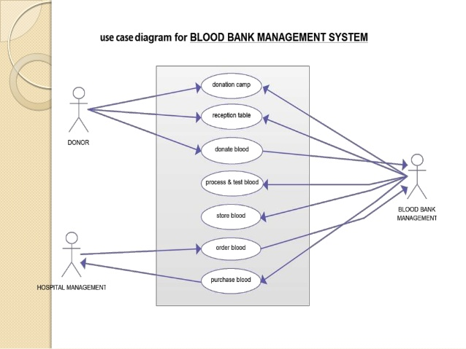

Slide 9
CLASS DIAGRAM:
Class diagram is a static diagram.Class diagram describes the attributes and operations of a class and also the constraints imposed on the system. The class diagrams are widely used in the modeling of objectoriented systems because they are the only UML diagrams, which can be mapped directly with object-oriented languages.Class diagram shows a collection of classes, interfaces, associations, collaborations, and constraints. It is also known as a structural diagram.

Slide 10
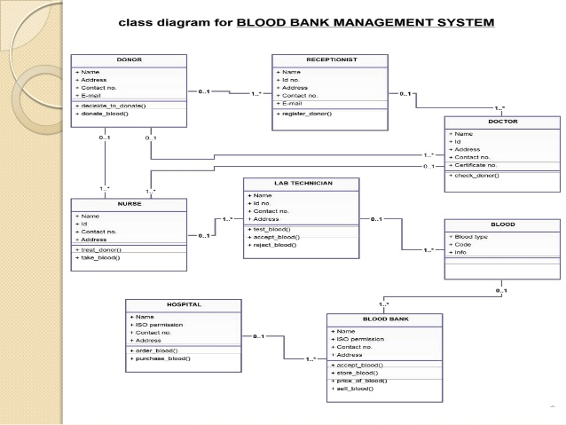

Slide 11
STATECHART DIAGRAM:
The name of the diagram itself clarifies the purpose of the diagram and other details. It describes different states of a component in a system. The states are specific to a component/object of a system.A Statechart diagram describes a state machine. State machine can be defined as a machine which defines different states of an object and these states are controlled by external or internal events.

Slide 12
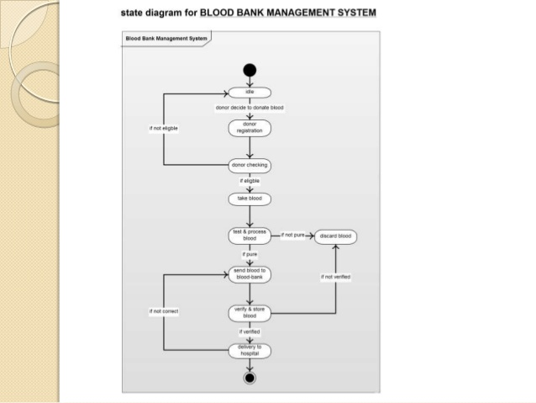

Slide 13
ACTIVITY DIAGRAM:
Activity diagram is another important diagram in UML to describe the dynamic aspects of the system.Activity diagram is basically a flowchart to represent the flow from one activity to another activity. The activity can be described as an operation of the system.control flow is drawn from one operation to another. This flow can be sequential, branched, or concurrent. Activity diagrams deal with all type of flow control by using different elements such as fork, join, etc.

Slide 14
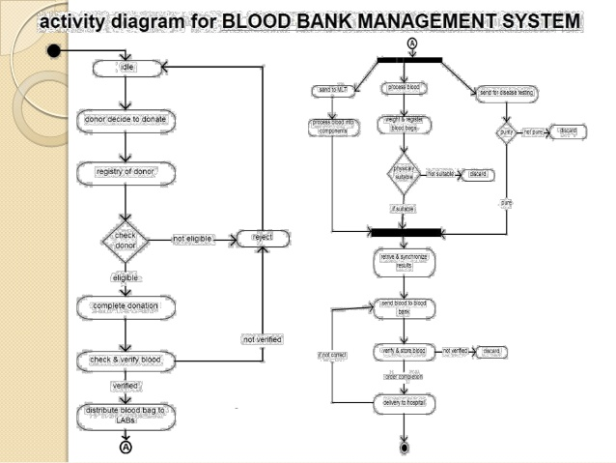

Slide 15
SEQUENCE DIAGRAM:
The sequence diagram captures the time sequence of the message flow from one object to another object.Following things are to be identified clearly before drawing the sequence diagram
Objects taking part in the interaction.
Message flows among the objects.
The sequence in which the messages are flowing.
Object organization.

Slide 16
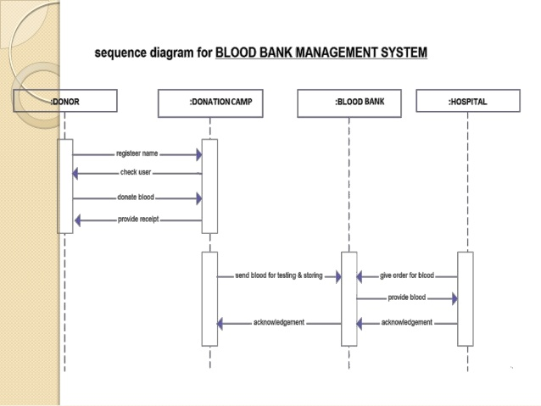

Slide 17
COLLABORATION DIAGRAM:
The collaboration diagram describes the organization of objects in a system taking part in the message flow.Following things are to be identified clearly before drawing the collaboration diagram
Objects taking part in the interaction.
Message flows among the objects.
The sequence in which the messages are flowing.
Object organization.

Slide 18
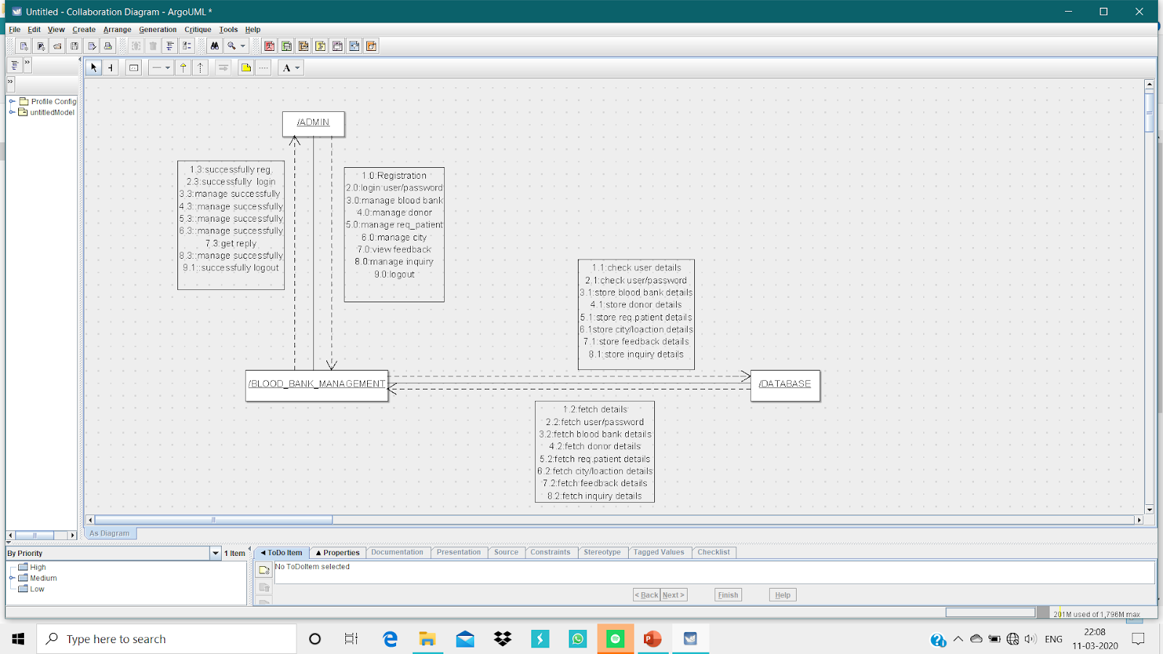

Slide 19
IMPLEMENTATION METHODOLOGY
Online Blood Donation management System project is aimed to developing an online Blood Donation Information. The entire Online Blood Donation management System project has been developed keeping in view of the distributed client server computing technology, in mind. The Blood Donation Agent is to create an e-Information about the donor and organization that are related to donating the blood. Through this Online Blood Donation management System application any person who is interested in donating the blood can register himself in the same way if any organization wants to register itself with this site that can also register.

Slide 20
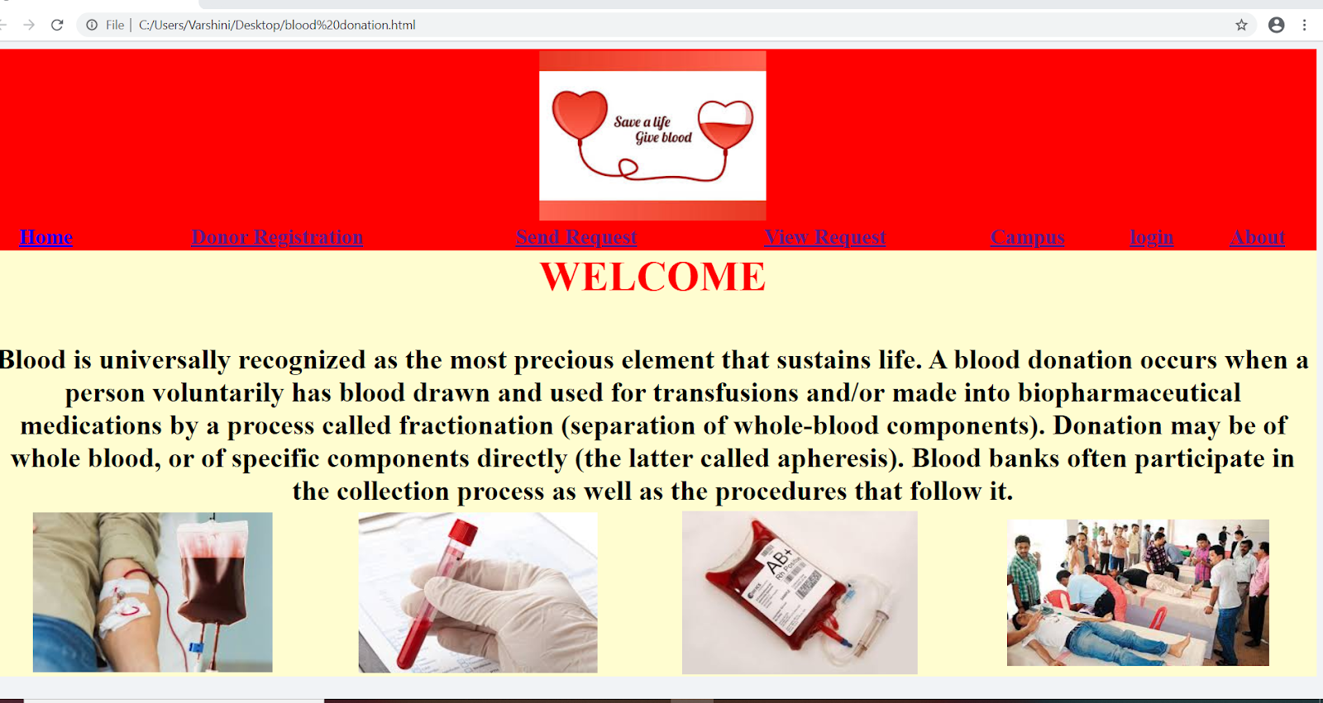
RESULT

Slide 21
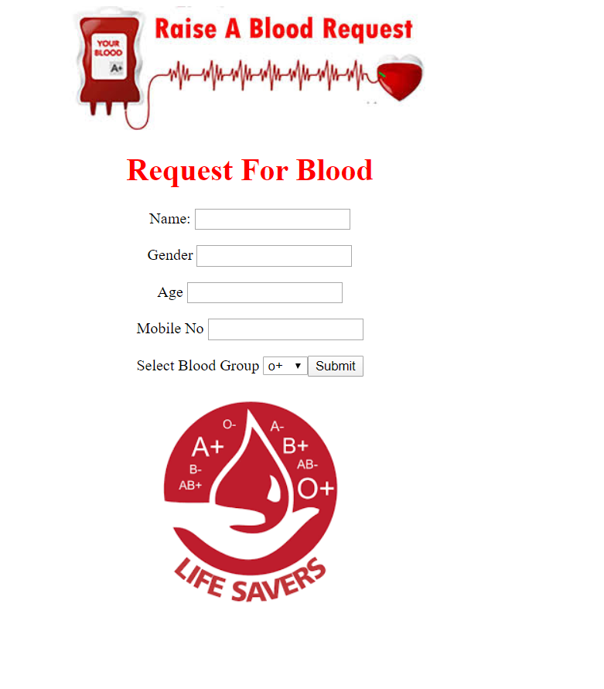

Slide 22
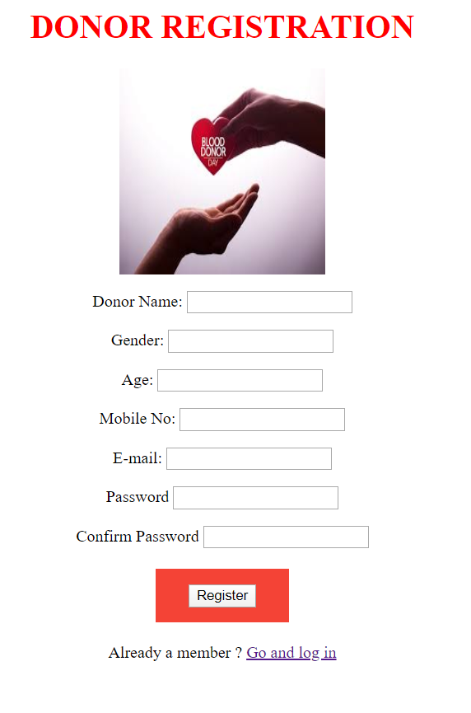

Slide 23
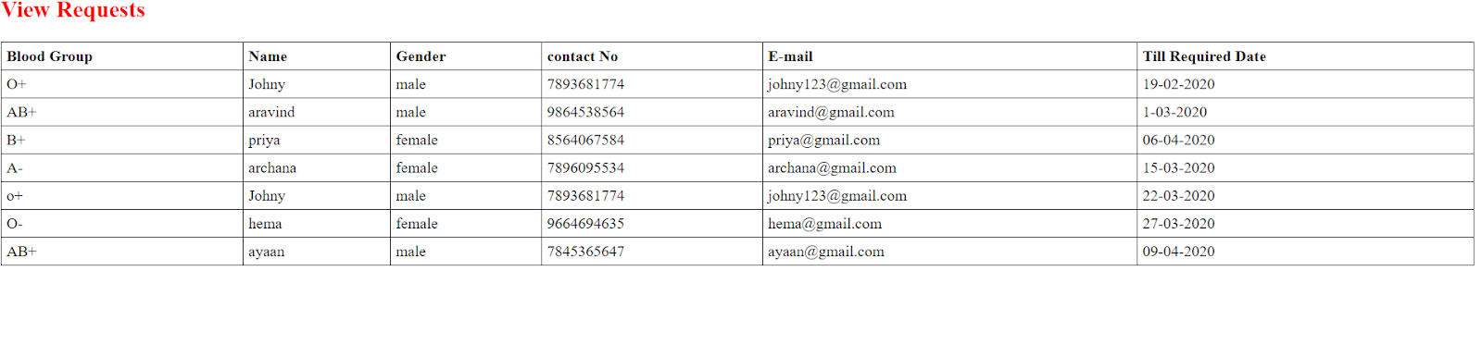
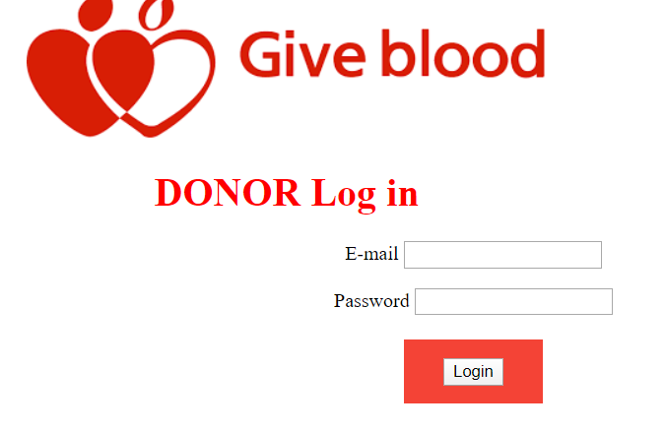

Slide 24
CONCLUSION:
In this project we tried to implement the centarlized blood bank management system.this project has many advantages to the society.as everything is centralised we can combine many objectives to perform effective analysis.effective analysis of data can help a lot in medical field as many other objects and fields can be added to this system for the differnt blood groups.

Slide 25
REFERENCES
en.wikipedia.org
www.google.com
www.about.com System Analyasis and Design Method, Publisher McHill

